Slide 1
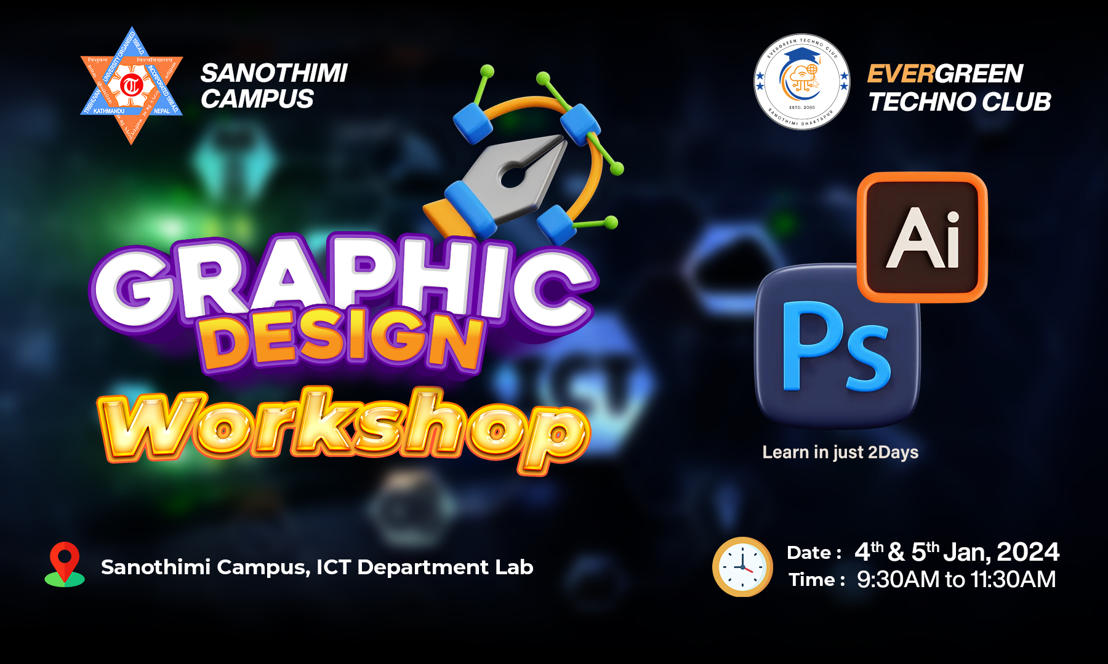

Slide 2
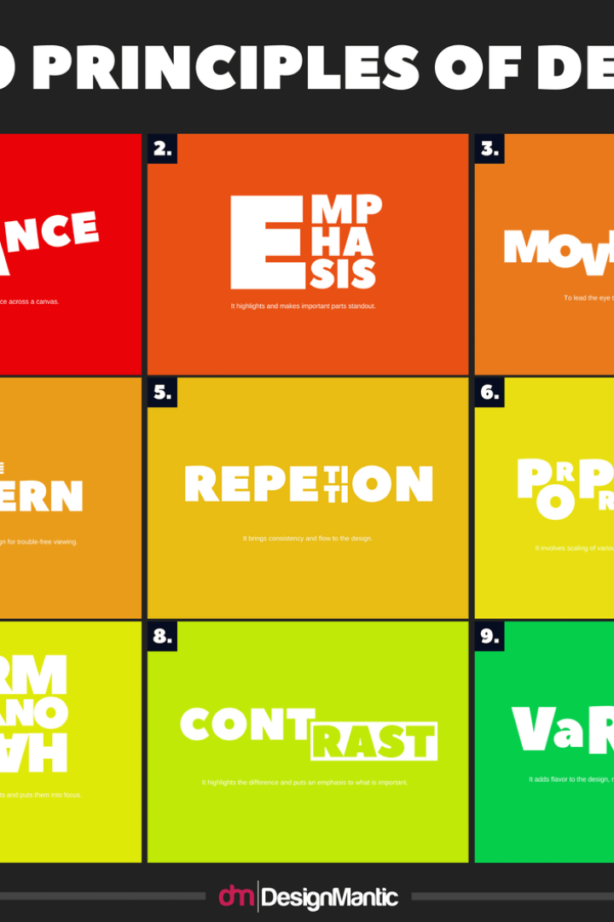
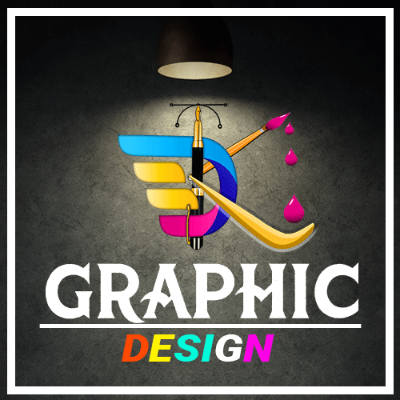
Graphic Design Principles Theory
Welcome to this presentation on graphic design principles theory. In this session, we will explore the key concepts of graphic design and learn how to effectively apply them to create stunning visuals.
PRESENTER BY : DHIRAJ KUMAR SHAH
Facebook Page : Dk.Graphic Design

Slide 3

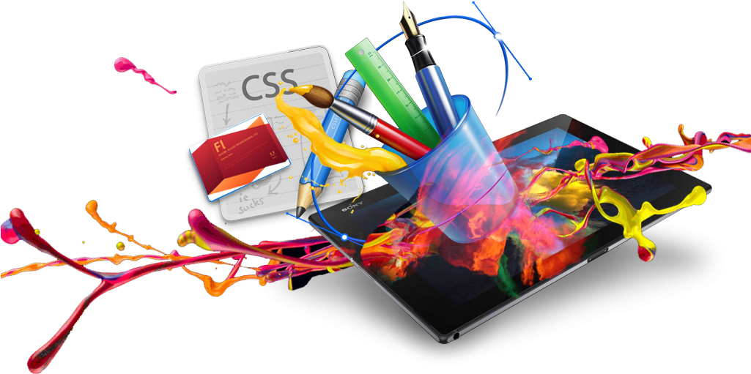
Graphic Design
Graphic design is the art of creating visual content, which includes using typography, images, colors, and shapes to communicate a message. Its ultimate goal is to make information easy to comprehend.
Graphic designers can work in many settings. You may work in-house at a company or agency or home as a freelancer. Graphic designers often work in:
Ad agencies
Web design firms
Marketing firms
Print and online publishers
Online and brick-and-mortar retailers
Non-profit organisations

Slide 4

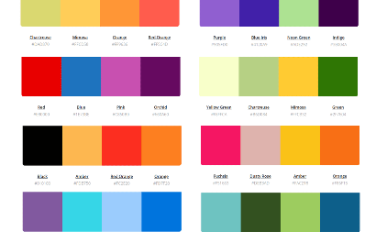
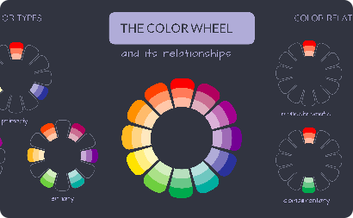
Color Theory
Psychological and cultural influences of color
Color models and color schemes
Importance and definition of color theory in graphic design
Colors can be described using a variety of models such as RGB, CMYK, and HSV. Color schemes such as monochromatic, analogues, complementary, and triadic can be used to create harmonious color combinations.
Colors evoke emotions, create a sense of atmosphere, provide context, and convey meaning based on culture, psychology, and personal associations.
Color is a critical component of any design, serving to communicate emotions, deliver a message, and provide aesthetic appeal. Understanding color theory is essential for effective visual communication.

Slide 5

Typography
1
Importance and definition of typography in graphic design
Typography is the art and science of designing and arranging typefaces to improve readability and visual appeal.
2
Typeface classification
There are five main classifications of typefaces: serif, sans-serif, script, display, and dingbat. Understanding their unique characteristics is essential for creating effective typography.
3
Typography hierarchy and legibility
Typography hierarchy refers to the visual arrangement of different types of content to communicate a clear message and create an easy-to-read design. Legibility is the measure of how easily a written language can be read and outlines several factors such as font choice and font size.

Slide 6
Composition
Importance and definition of composition in graphic design
Rule of thirds and other composition techniques
Hierarchy and visual hierarchy
A proper hierarchy and visual hierarchy can help a viewer understand a complex design or message. Design elements should be organized in a clear, logical manner that guides the viewer's attention to the most important information.
The rule of thirds, symmetry, and asymmetry can be used as basic composition techniques. In addition, negative space, alignment, and balance play important roles in creating an effective composition.
Composition refers to the arrangement of elements in a design, taking into account their size, color, shape, and visual weight to create a harmonious and pleasing visual.

Slide 7

Line Elements
Importance of lines in graphic design
Types of lines
Straight, curved, zigzag, dotted, dashed; each type of line has a unique impact on the mood of an image and can imbue it with different meanings.
Lines are fundamental building blocks of design, serving to create structure, define boundaries, and convey emotion in an image.
Use of lines in composition
Lines can be used to create focal points, guide the eye, or lead the viewer through a specific path in the design, and can also be used to create a sense of movement in an image.

Slide 8


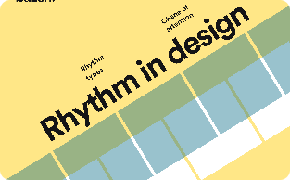

Principles of Design
Balance
Contrast
Rhythm
Unity
Balance refers to the even distribution of the elements in a design. This can be achieved by making sure the visual weight of each element is equal, or by using asymmetry and negative space to create movement.
Contrast refers to the difference between the elements in a design. This can be achieved by using different colors, font sizes, or shapes to make certain elements stand out.
Rhythm refers to the repetition of specific design elements to create a visual flow. This can be achieved by repeating the use of certain colors, shapes, or patterns.
Unity refers to creating a cohesive design that is aesthetically pleasing and visually appealing. This can be achieved by consistently applying specific design elements throughout the design process.

Slide 9

Introduction to Graphic Design Principles
1
Why Design Principles Matter
2
Key Design Principles
3
Design Principles in Action
Learn why understanding design principles is key to creating effective visual communication.
Explore fundamental graphic design concepts like composition, typography, and color theory.
Experience how these elements work together to create stunning visuals and engaging campaigns.

Slide 10
Adobe Photoshop: Bring Your Imagination to Life
Overview of Photoshop
Basic Tools and Features
Get to know the world's leading image editing software.
Learn the essentials and build a strong foundation for your Photoshop skills.
Photoshop for Graphic Design
Advanced Tips and Tricks
See how to use tools like layers, masks, and effects to create bold and dynamic designs.
Looking to take your skills to the next level? Discover some advanced techniques in Photoshop.

Slide 11



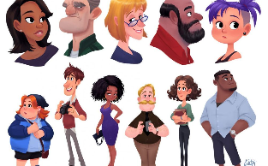
Adobe Illustrator: Where Imagination Meets Precision
Overview of Illustrator
Basic Tools and Features
Illustrator for Graphic Design
Advanced Techniques
Discover how to turn your ideas into reality with the industry-standard vector graphics editor.
Learn the essential tools and techniques to create professional-grade graphics.
See how the pen tool and other Illustrator features can take your designs to new heights.
Take your skills to the next level with some expert-level tips and tricks in Illustrator.

Slide 12

The Art of Design
1
Sketching Ideas
Learn how to turn your ideas into rough sketches and plan your artistic journey.
Creating a Vision
2
See how to define your creative vision and bring it to life with Adobe tools.
3
Finalizing the Design
Refine your design, receive feedback, and produce a finished masterpiece.

Slide 13

Designing for Impact
1
Effective Design for Social Media
2
Designs that Tell a Story
See how to use visual storytelling to convey a message and evoke emotions.
Learn how to create engaging and shareable posts, stories, and ads on social media platforms.
3
Creating Graphics on a Budget
Get tips for designing on a budget and making the most of free resources.

Slide 14
Beyond the Basics
Design Thinking
Collaboration
Design for Web and Mobile
Apply design-thinking principles to plan and execute your designs.
Use Adobe's collaboration tools to work with others and share your creations.
Learn how to design for the web and mobile platforms with Adobe tools and resources.

Slide 15
Conclusion
Use design principles to guide your work
Explore these concepts further
Learn more about graphic design by studying the work of other designers and experimenting with your own designs that apply these principles.
Apply the principles we've covered in this presentation to create more effective, visually appealing designs that are both aesthetically pleasing and meaningful.

Slide 16


Resources for graphic design
Stock Photos for free
Pixabay.com
Unplash.com
Pixel.com
Png Photos for free
pngwing.com
freepng.com
anyrgb.com
Stock Video for free
Pixabay.com
brust.com
Pixel.com
Photoshop learn on youtube for free
GFXmentor
Rajeev mehtha
Nikhil pawar
gra
Graphic Templates for free
graphicfamily.com
graphicburger.com
freevector.com
Impression on Design for free
Pinterest
Dribble.com
Behance.com

Slide 17

Conclusion and Q&A
Now that you've learned about graphic design principles and Adobe software, it's time to put them into practice! Feel free to ask any questions you may have and get ready to take your designs to the next level.

